Slide 1
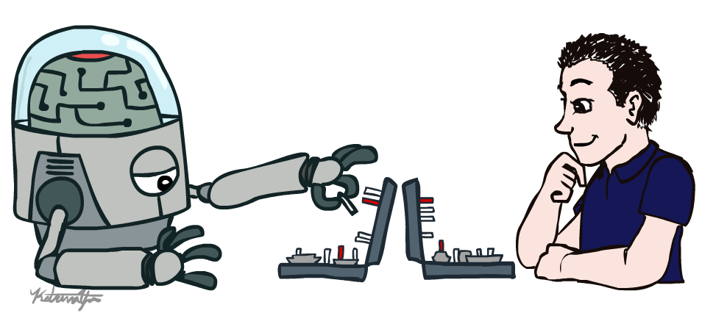
CSE 3521: Introduction to Artificial Intelligence
[These slides are partially adapted from the UC Berkeley. CS188 Intro to AI at UC Berkeley]

Slide 2


Course Information
Instructor:
Jeniya Tabassum (bintejafar.1@osu.edu)
Grader:
Prashant Serai (serai.1@osu.edu)
Course website:
https://sites.google.com/view/osu-cse-3521-5521/

Slide 3
Course Information
Carmen Zoom:
For online lectures and office hours and/or exams
Carmen:
For homework submission
Proctorio/Carmen quizzes:
For exams and quizzes

Slide 4
Grading and Homework
Grading Policy
Guidelines
Homework & Labs – 40%
Quizzes & participation – 10%
Midterm – 25%
Final – 25%
Expect 5 homework/programming assignments over the course.
Homework submissions are individual, but feel free to discuss.

Slide 5
Pre-requisites & What to Expect?
Pre-requisites
Required: CSE 2331 (Foundations 2)
Suggested: MATH 3345 (Foundations of Higher Math), Stat 3460 or 3470 (Intro to Probability and Stats), MATH 2568 (Linear Alg)
Extensive math and programming related Homework
Multivariate calculus, linear algebra, and probability
Python
AI algorithms often difficult to debug
We strongly recommend that you start early.

Slide 6

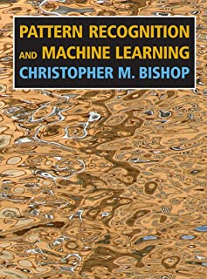
Textbook
Not required, but for students who want to read more we recommend
Warning: Not course textbooks, so our presentation does not necessarily follow the presentation in the book.
Russell & Norvig,
AI: A Modern Approach, 3rd Ed.
Bishop,
Pattern Recognition and Machine Learning

Slide 7


**Important*** This Week
Register
If you are wait-listed, you might or might not get in depending on how many students drop ☹
Math review/self-diagnostic:
Check suggested/require materials
important to check your preparedness for second half
Python:
Check suggested tutorials on the website

Slide 8
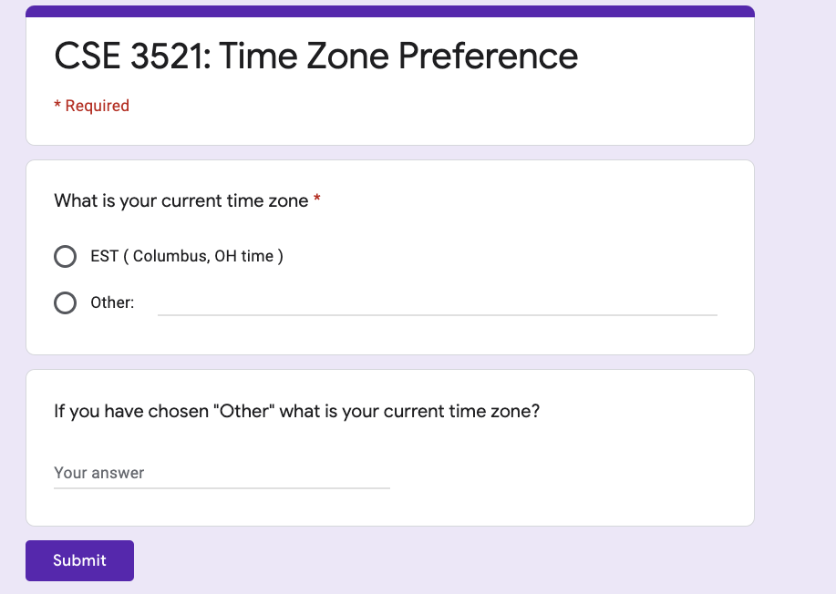
**Important*** Do Now
Time Zone
https://forms.gle/LwRQuRQQEPYRSSFP7

Slide 9
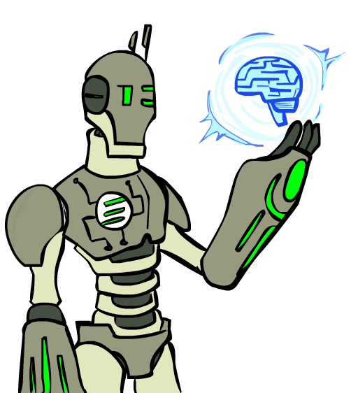
Today
What is artificial intelligence?
What is this course?
What can AI do?
What is an AI agent?
How to evalute an AI agent?

Slide 10
Some Definitions of AI
“The scientific understanding of the mechanisms underlying thought and intelligent behavior and their embodiment in machines”
– American Association of Artificial Intelligence (AAAI)
“Artificial Intelligence is the branch of computer science that is concerned with the automation of intelligent behavior”
– Luger and Stubblefield
“AI strives to understand and build intelligent entities (also helps us to learn more about ourselves)”
– Russell and Norvig

Slide 11
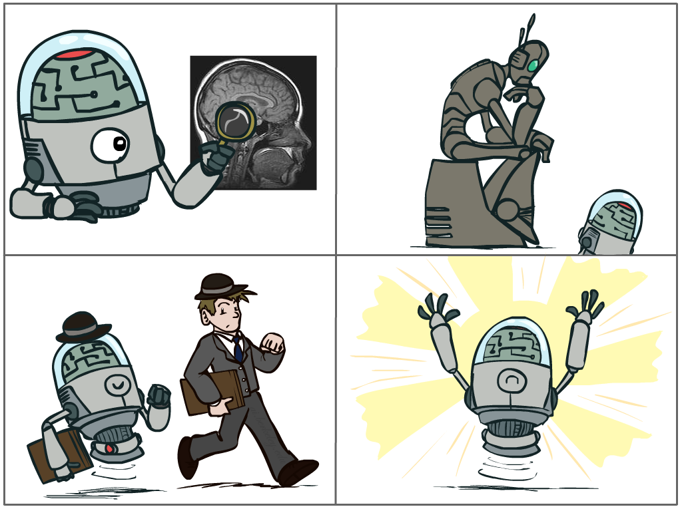
What is AI?
The science of making machines that:
Think like people
Think rationally
Act like people
Act rationally
Notes:
Top left: Think like people --- cognitive science, neuroscience
Bottom left: act like people --- actually very early definition, dating back to Alan Turing --- Turing test; problem to do really well you start focusing on things like don’t answer too quickly what the square root of 1412 is, don’t spell too well, and make sure you have a favorite movie etc. So it wasn’t really leading us to build intelligence
Think rationally – long tradition dating back to Aristotle --- but not a winner, because difficult to encode how to think, and in the end it’s not about how you think, it’s about how you end up acting

Slide 12
What is AI?
Think like people
Think rationally
Act like people
Act rationally
How can we test it?
Notes:
Top left: Think like people --- cognitive science, neuroscience
Bottom left: act like people --- actually very early definition, dating back to Alan Turing --- Turing test; problem to do really well you start focusing on things like don’t answer too quickly what the square root of 1412 is, don’t spell too well, and make sure you have a favorite movie etc. So it wasn’t really leading us to build intelligence
Think rationally – long tradition dating back to Aristotle --- but not a winner, because difficult to encode how to think, and in the end it’s not about how you think, it’s about how you end up acting

Slide 13
The Turing Test
Ingredients:
Human Judge, unknown Entity
2 computer terminals in different room
Recipe:
Have human Judge sit at one computer
Judge converses with Entity via chat window for 5 minutes
Judge decides if Entity is human or computer

Slide 14
Which is Which?
Left hand side
Right hand side
Judge: Hi what’s your name?
Entity: I don’t know
Judge: My name’s Jane. I live in London. Where do you live?
Entity: I live in London as well
Judge: Do you like living in London?
Entity: Yes I like it because there are a lot of things to do and it is the capital city of England
Judge: What’s my name?
Entity: sorry?
Judge: What’s my name?
Entity: Jane
Judge: And what’s your name?
Entity: I don’t know
Judge: What color is the carpet in your room
Entity: I like pink; what do you like?
Judge: I like pink. My name is John. What’s your name?
Entity: Red. Hello John. Its nice to meet such a fine person as yourself.
Judge: Red is my favorite color. What’s yours?
Entity: My favorite color is red.
Judge: You use American spelling. Are you in the USA?
Entity: But you are not even American. Just remember atheism is only a belief system. And it too can be forced on people who don’t agree.
Judge: How do you like your eggs – ever easy or sunny side up?
Entity: How I wonder if I like my eggs-over easy or sunny side up? This is so explainable. That list makes me feel unsure John.
Example taken from “Turing’s Imitation Game,” by Warwick and Shah (2016)

Slide 15
How to do well in the Turing Test?
Chatting “like a human” involves:
Generating coherent language
Responding appropriately to unexpected inputs
…

Slide 16
What is not shown?
The Turing Test does not show
Understanding or thinking
Ability to learn
Interaction with an unconstrained world
Processing sensory input
Having knowledge
Much of anything useful, really

Slide 17
Act Rationally; Rational Decisions
We’ll use the term rational in a very specific, technical way:
Rational: maximally achieving pre-defined goals
Rationality only concerns what decisions are made (not the thought process behind them)
Goals are expressed in terms of the utility of outcomes
Being rational means maximizing your expected utility
Rational behavior = doing the right thing, does not necessarily involve thinking

Slide 18
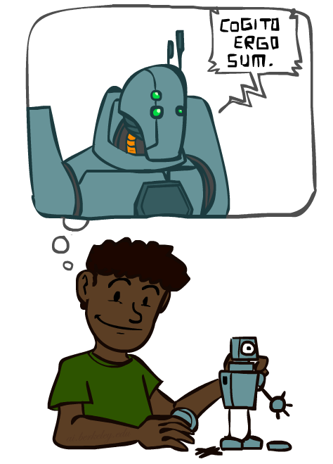
A (** Short **) History of AI
1940-1950: Early days
1943: McCulloch & Pitts: Boolean circuit model of brain
1950: Turing's “Computing Machinery and Intelligence”
1950—70: Excitement: Look, Ma, no hands!
1950s: Early AI programs, including Samuel's checkers program, Newell & Simon's Logic Theorist, Gelernter's Geometry Engine
1956: Dartmouth meeting: the term “Artificial Intelligence” adopted
1965: Robinson's complete algorithm for logical reasoning
1970—90: Knowledge-based approaches
1969—79: Early development of knowledge-based systems
1980—88: Expert systems industry booms
1988—93: Expert systems industry busts: “AI Winter”
1990—: Statistical approaches
Resurgence of probability, focus on uncertainty
General increase in technical depth
Agents and learning systems… “AI Spring”?
2000—: Where are we now? (Machine learning, neural networks, deep learning, …)
Notes:
Million dollar computer with less computation than your phone
MT was

Slide 19
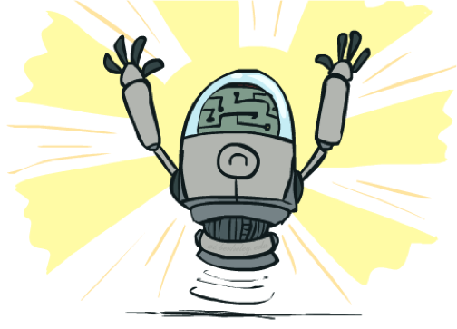
What AI Can Do
Quiz: Which of the following can be done at present?
Play a decent game of table tennis?
Play a decent game of Jeopardy/Go/Atari/Star raft?
Drive safely along a curving mountain road (w/o other traffic agents)?
Drive safely along High Street?
Buy a week's worth of groceries on the web?
Buy a week's worth of groceries at Worthington Farmers Market?
Discover and prove a new mathematical theorem?
Converse successfully with another person for an hour?
Perform a surgical operation?
Put away the dishes and fold the laundry?
Translate spoken Chinese into spoken English in real time?
Write an intentionally funny story?

Slide 20
What AI Can Do
Quiz: Which of the following can be done at present?
Play a decent game of table tennis?
Play a decent game of Jeopardy/Go/Atari/Star raft?
Drive safely along a curving mountain road (w/o other traffic agents)?
Drive safely along High Street?
Buy a week's worth of groceries on the web?
Buy a week's worth of groceries at Worthington Farmers Market?
Discover and prove a new mathematical theorem?
Converse successfully with another person for an hour?
Perform a surgical operation?
Put away the dishes and fold the laundry?
Translate spoken Chinese into spoken English in real time?
Write an intentionally funny story?

Slide 21
Important research areas related to AI
Speech processing
Natural language processing
Computer vision
Robotics
Logic
Game playing
Decision making
Autonomous driving
……

Slide 22
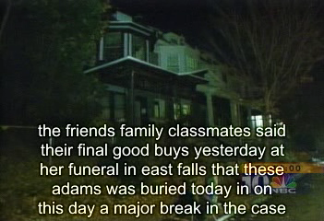
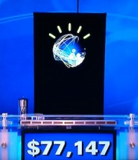
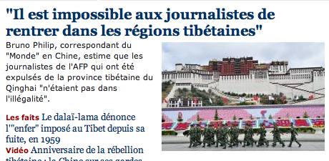
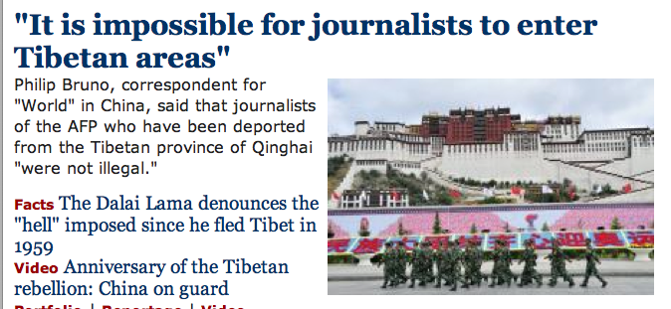
Speech Processing & Natural Language Processing
Speech technologies (e.g. Siri, Alexa)
Automatic speech recognition (ASR)
Text-to-speech synthesis (TTS)
Dialog systems
Language processing technologies
Question answering
Machine translation
Web search
Text classification, spam filtering, etc…

Slide 23

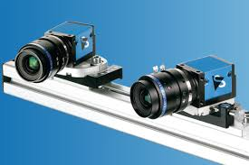
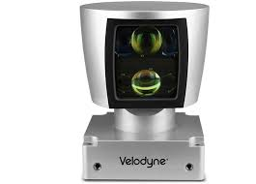
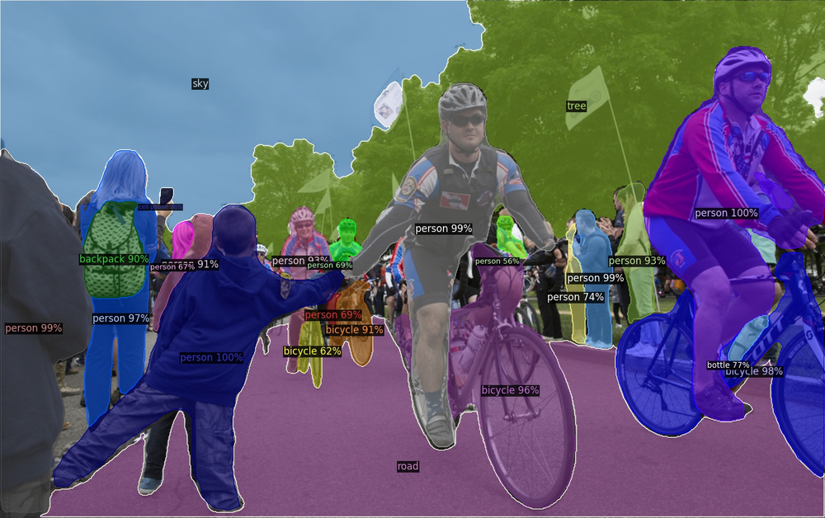
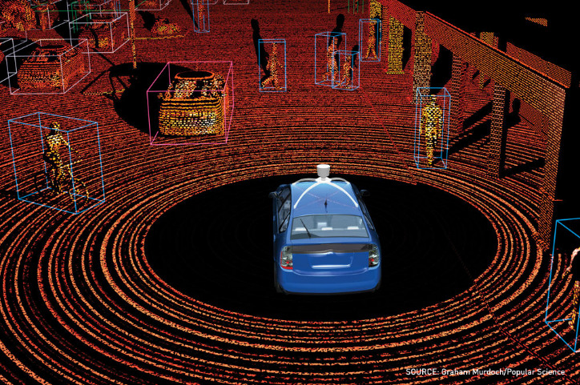
Computer Vision
Object and face recognition
Scene segmentation
Image classification
[Source: Detectron2]
[Source: Graham Murdoch/Popular Science]

Slide 24
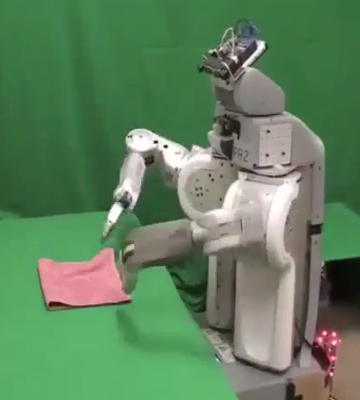
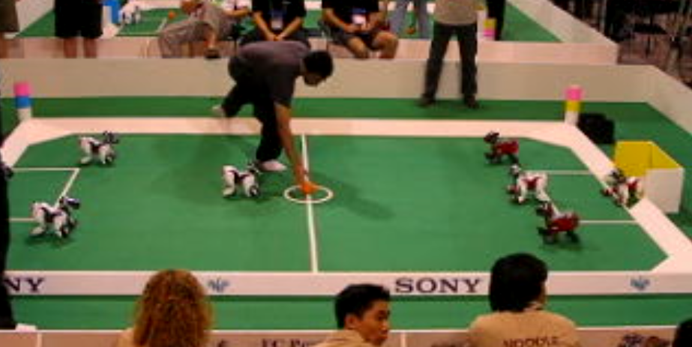
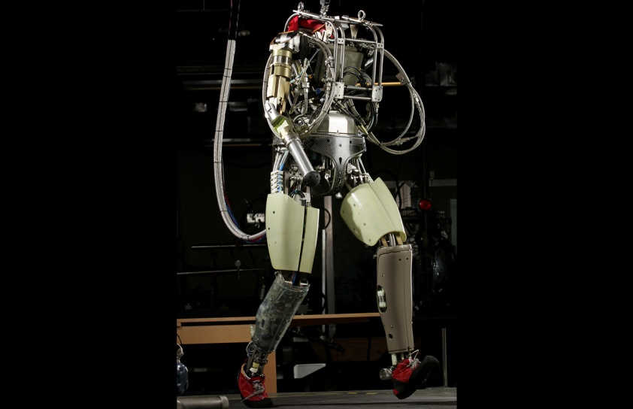
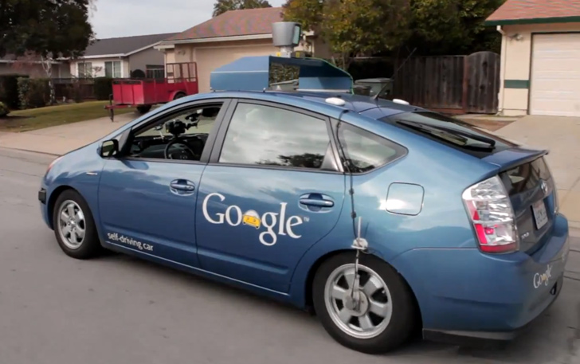
Robotics
Robotics
Part mech. eng.
Part AI
Reality much
harder than
simulations!
Technologies
Vehicles
Rescue
Soccer!
Lots of automation…
[Images from UC Berkeley, Boston Dynamics, RoboCup, Google]

Slide 25
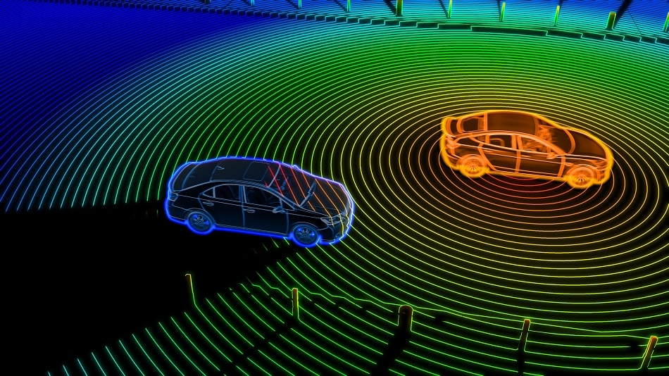
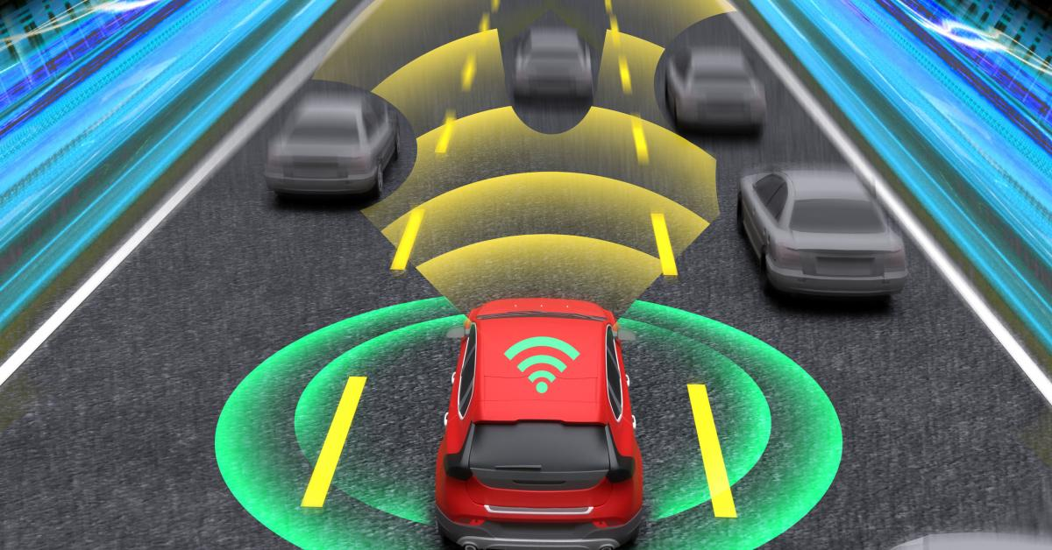
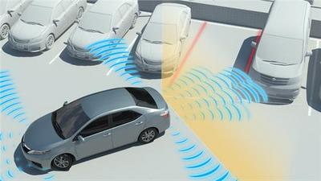
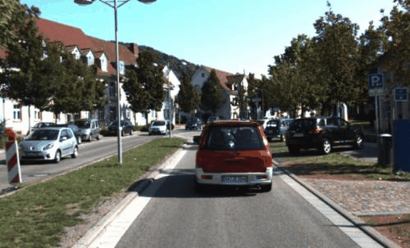
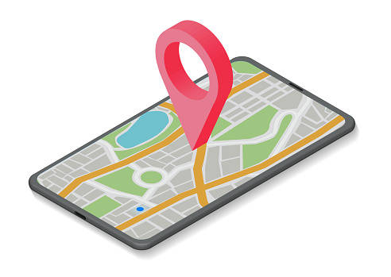
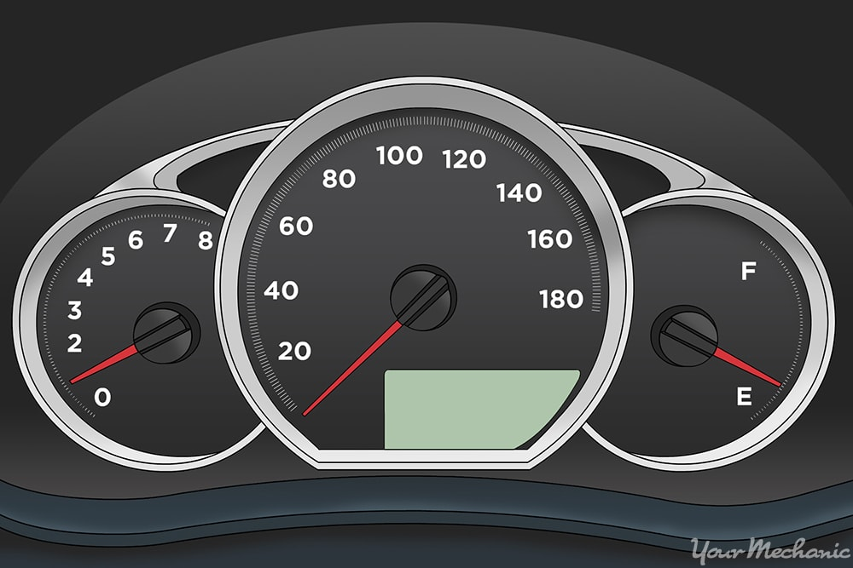
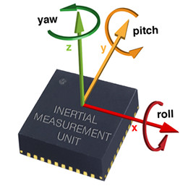


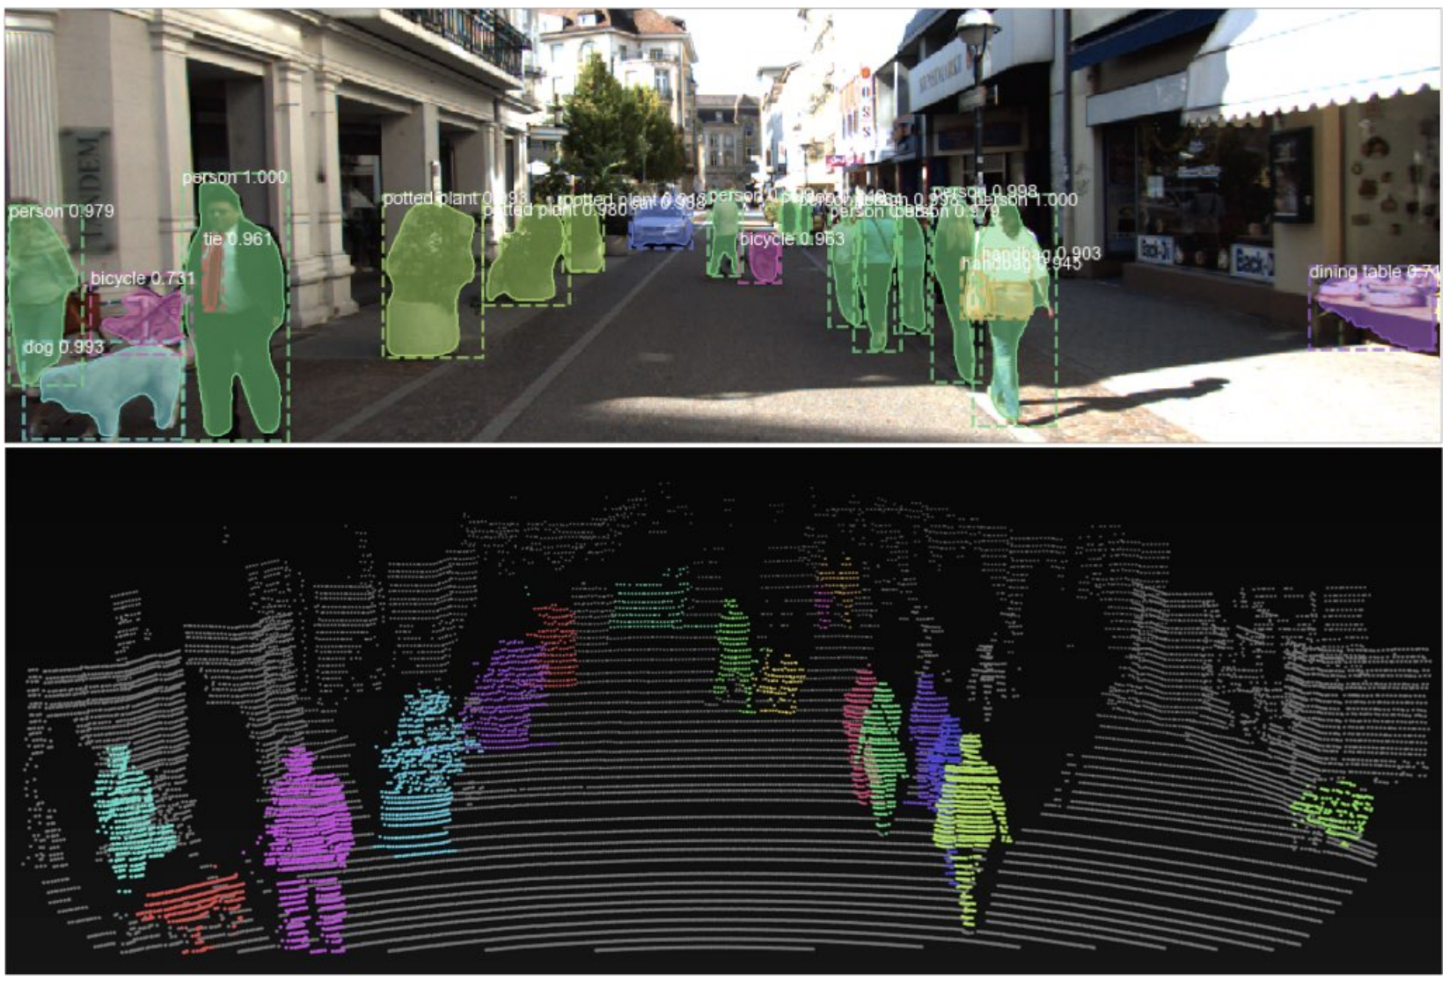
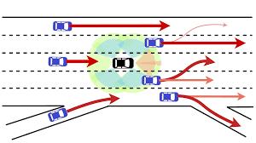



Autonomous Driving
LiDAR
Radar
Sonar
Camera
Others
Perception
Prediction & Planning
Action & decision
Notes:
An self-driving car perceive the world/environment via a variety of sensors, predict how other traffic agents will move and plan how to move, and finally perform actions on the steering, accelerator, etc.

Slide 26
How can we evaluate such agent?

Slide 27
What is AI?
The science of making machines that:
Think like people
Think rationally
Act like people
Act rationally
Notes:
Top left: Think like people --- cognitive science, neuroscience
Bottom left: act like people --- actually very early definition, dating back to Alan Turing --- Turing test; problem to do really well you start focusing on things like don’t answer too quickly what the square root of 1412 is, don’t spell too well, and make sure you have a favorite movie etc. So it wasn’t really leading us to build intelligence
Think rationally – long tradition dating back to Aristotle --- but not a winner, because difficult to encode how to think, and in the end it’s not about how you think, it’s about how you end up acting

Slide 28
The Fundamental question for this course topics
(and really this whole AI field !):
How do you turn a real-world
problem into an AI solution?

Slide 29
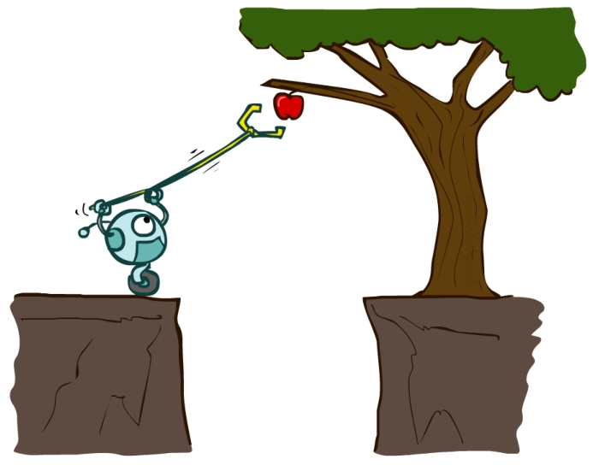
AI – Agents and Environments
Much (though not all!) of AI is concerned with agents operating in environments.
Environment – the problem setting
Agent – an entity that perceives its environment through sensors and acts upon that environment through effectors (actuators)

Slide 30

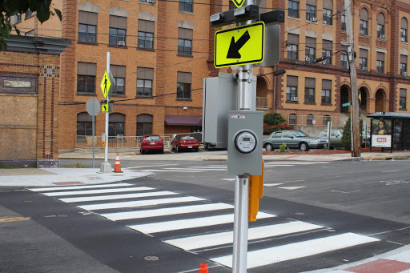
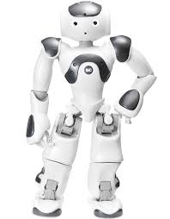
AI – Agents and Environments
Humans
Cross walks
perception
Sensors: eyes, ears, etc.
Effectors: hands, legs, mouth, etc.
Environment
Agent
action
Sensors: cameras, 3D sensors, etc.
Effectors: various motors, robot arms, etc.
Robots

Slide 31
AI – Agents and Environments
Humans
Cross walks
perception
Sensors: eyes, ears, etc.
Effectors: hands, legs, mouth, etc.
Environment
Agent
action
Sensors: cameras, 3D sensors, etc.
Effectors: various motors, robot arms, etc.
Percept: Agent’s perceptual inputs at any given instant
Percept sequence: Complete history of everything agent has perceived
Agent’s choice of action (e.g., walk forward for a step, push the bottom) can depend on entire percept sequence
Robots

Slide 32
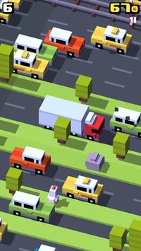
Fleshing it out
Performance – measuring the agent’s success
Environment – what populates the problem’s world?
Actuators – what can the agent act with?
Sensors – how can the agent perceive the world?

Slide 33
Peas in Automated-Taxi
Performance – Safe, fast, legal, comfortable trip, maximize profits
Environment – Roads, other traffic agents (e.g., pedestrians), customers
Actuators – Steering, accelerator, brake, signals, horn, display
Sensors – Cameras, sonar, LiDAR, radar, speedometer, GPS, odometer, accelerometer, engine sensors, microphone/keyboard

Slide 34
Peas: Other Examples
Agent Type | Perf. Measure | Environment | Actuators | Sensors
Medical diagnosis system | Healthy patient, minimize costs/lawsuits | Patient, hospital, staff | Display questions, tests, diagnoses, treatments, referrals | Keyboard entry of symptoms, findings, patient’s answers
Satellite image analysis system | Correct image classification | Downlink from orbiting satellite | Display classification of scene | Color pixel arrays (cameras)
Part-picking robot | Percentage of parts in correct bins | Conveyor belt with parts, bins | Jointed arm and hand | Camera, joint angle sensors
Refinery controller | Maximize purity, yield, safety | Refinery, operators | Valves, pumps, heaters, displays | Temperature, pressure, chemical sensors
Interactive English tutor | Maximize student’s score on test | Set of students, testing agency | Display exercises, suggestions, corrections | Keyboard entry

Slide 35
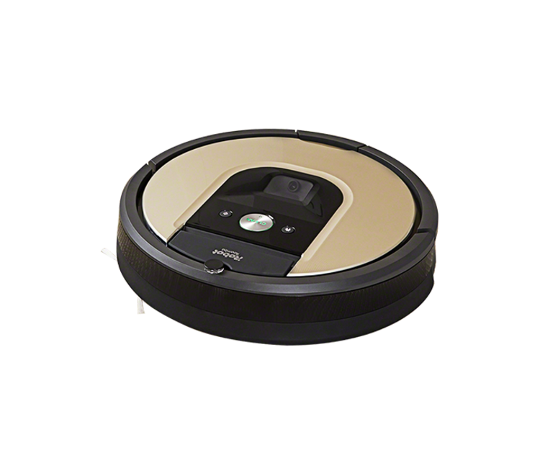
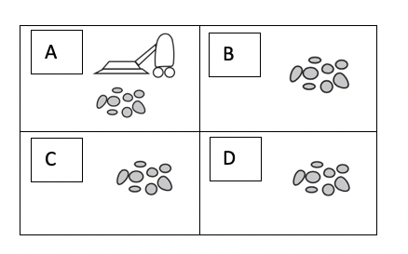
In Class Exercise
Give a ‘PEAS’ description of the task environment for the following vacuum-cleaner world with four locations.

Slide 36
In Class Exercise
Give a ‘PEAS’ description of the task environment for the following vacuum-cleaner world with four locations.
Performance – cleanness, efficiency, distance traveled
Environment – room with 4 squares
Actuators – wheels, brushes, vacuum extractor
Sensors – dirt detection

Slide 37
What makes an AI agent
Agent – an entity that perceives its environment through sensors, and acts on it with effectors (actuators).
Percepts are constrained by Sensors + Environment
Actions are constrained by Actuators + Environment
Sensors
Actuators
Percepts
Actions
Agent
Environment

Slide 38
What makes an AI agent
Agent – an entity that perceives its environment through sensors, and acts on it with effectors (actuators).
Percepts are constrained by Sensors + Environment
Actions are constrained by Actuators + Environment
Sensors
Actuators
Percepts
Actions
Agent
?
Environment
Agent Function (policy) – how does it choose the action?

Slide 39
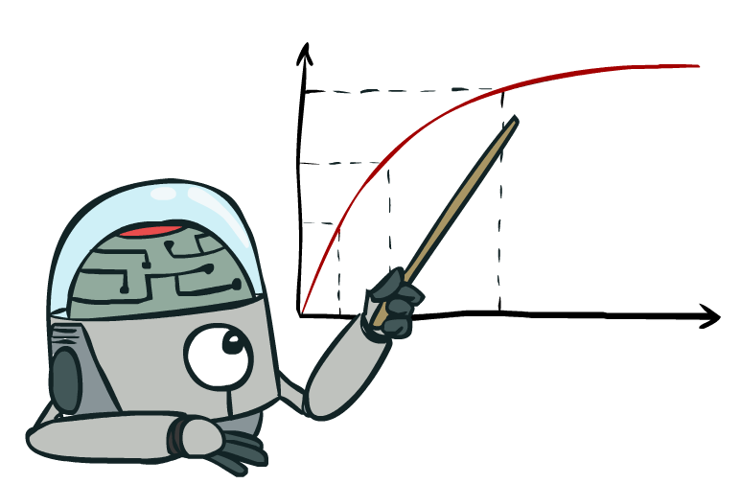
What is a rational AI agent?
A rational agent always acts to maximize its expected performance measure, given current percept/state
Rationality ≠ omniscience
There is “uncertainty” in the environment.
That is why we emphasize “expected”.

Slide 40
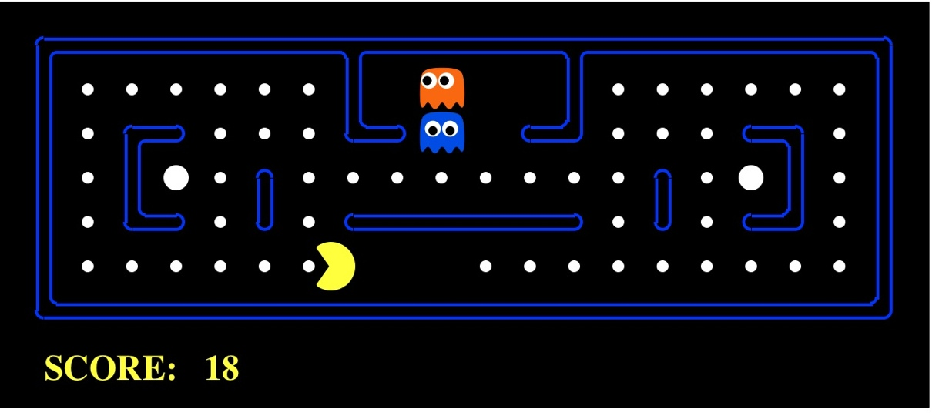

Our Sample Agent
Pacman
Spam Detector
Percepts – squares around Pacman
Actions – move U/D/L/R
Environment – map with walls, dots, and ghosts
Percepts – sender, subject line, body of current email
Actions – mark Spam/Not Spam
Environment – your email inbox

Slide 41
Summary
Description of AI (and intelligent agent)
Description of an AI agent
PEAS description

